Slide 1
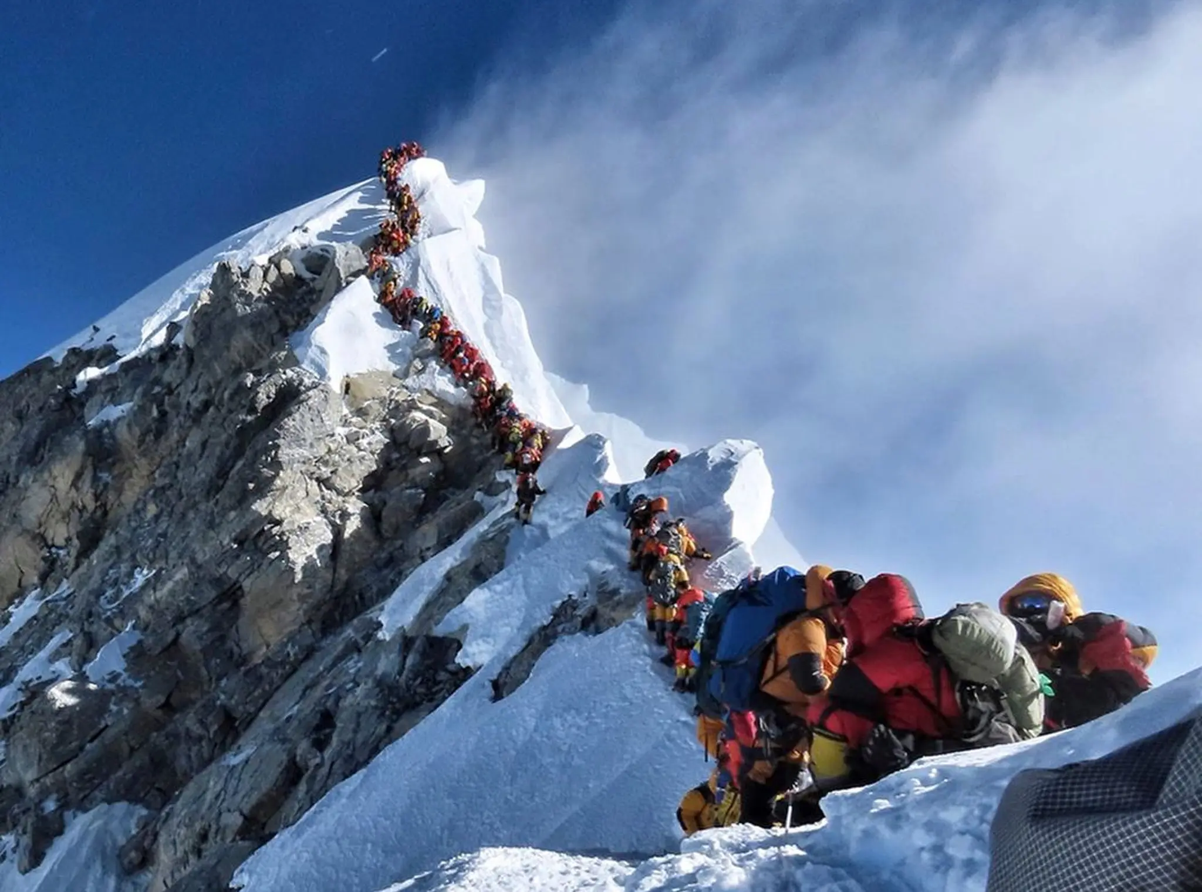

Slide 2

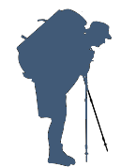

Climbers who made the summit
Climbers who didn’t make the summit
Climbers who died on the expedition

